Slide 1
Chapter 2
Entrepreneurial Intentions and
Corporate Entrepreneurship
McGraw-Hill/Irwin
Copyright © 2010 by The McGraw-Hill Companies, Inc. All rights reserved.

Slide 2
Corporate Entrepreneurship :
Entrepreneurial action within an established organization.

Slide 3

Examples : Hewlett-Packard in the mid-1990s

Slide 4
_x000b_Jeff ,
Given $8M and asked by VP of marketing and sales to “figure out e-commerce for the company”
No rules
“right one” to focus on. They picked the web - Right decision

Slide 5

Great things – by People

Slide 6

Facebook - CUlture

Slide 7
Causes for Interest in Corporate Entrepreneurship?
Social
  doing your own thing”
  self-actualization
Cultural
  Self-recognition
  Praise
business levels
  Hyper competition
  new product development,
  diversification, increased productivity, and decreasing costs

Slide 8
Managerial Versus Entrepreneurial
Decision Making
Entrepreneurial management is distinct from traditional management in terms of:
  Strategic orientation.
  Commitment to opportunity.
  Commitment of resources.
  Control of resources.
  Management structure.
  Reward philosophy.
  Growth orientation.
  Entrepreneurial culture.

Slide 9
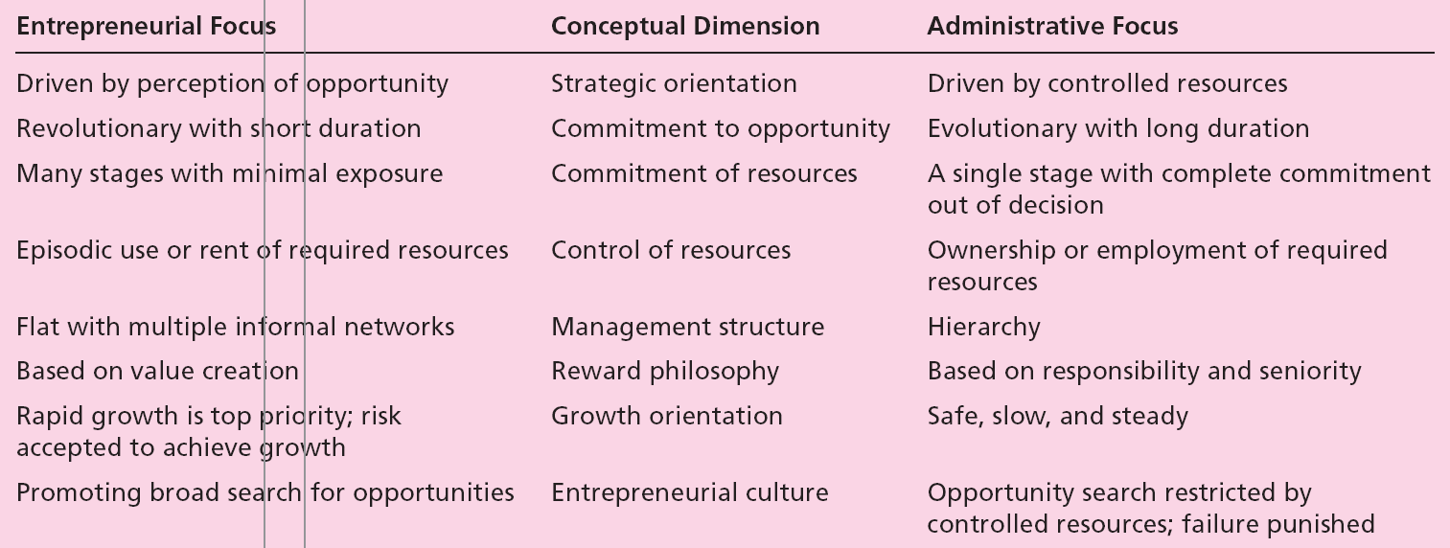
Table 2.1 – Distinguishing Entrepreneurially from Traditionally Managed Firms

Slide 10
Managerial Versus Entrepreneurial
Decision Making (cont.)
  Corporate entrepreneurship is most strongly reflected in the following endeavors:
    New business venturing (corporate venturing) - The creation of a new business within an existing organization.
    Innovativeness - Product and service innovation, with emphasis on development and innovation in technology.
    Self-renewal - Transformation through renewal of the key ideas on which an organization is built.
    Proactiveness - Includes initiative, risk taking, competitive aggressiveness, and boldness.

Slide 11
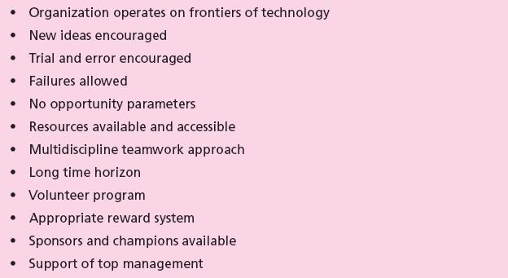
Table 2.3 - Characteristics of an Entrepreneurial Environment

Slide 12

Table 2.4 - Leadership Characteristics of a Corporate Entrepreneur

Slide 13
Establishing Corporate Entrepreneurship in the Organization
Step one:
  Secure a commitment to corporate entrepreneurship in the organization by top, upper, and middle management levels.
  Establish initial framework and embrace the concept.
  Identify, select, and train corporate entrepreneurs.

Slide 14
Establishing Corporate Entrepreneurship in the Organization (cont.)
Step two:
  Identify ideas and areas that top management is interested in supporting.
  Identify amount of risk money available to develop the concept.
  Establish overall program expectations and target results of each corporate venture.
  Establish mentor/sponsor system.
Step three:
  Use of technology to ensure organizational flexibility.

Slide 15
Establishing Corporate Entrepreneurship in the Organization (cont.)
Step four:
  Identify interested managers to train employees and share their experiences.
Step five:
  Develop ways for the organization to get closer to its customers.
Step six:
  Learn to be more productive with fewer resources.

Slide 16
Establishing Corporate Entrepreneurship in the Organization (cont.)
Step seven:
  Establish a strong support structure for corporate entrepreneurship.
Step eight:
  Tie rewards to the performance of the entrepreneurial unit.
Finally:
  Implement an evaluation system that allows successful entrepreneurial units to expand and unsuccessful ones to be eliminated.

Slide 17
Establishing Corporate Entrepreneurship in the Organization (cont.)
Problems and Successful Efforts
  A study found that new ventures started within a corporation performed worse than those started independently by entrepreneurs.
  Reasons cited:
    Corporation’s difficulty in maintaining a long-term commitment.
    A lack of freedom to make autonomous decisions.
    A constrained environment.
  On average, independent start-ups become:
    Profitable twice as fast.
    End up twice as profitable.

Slide 18
Establishing Corporate Entrepreneurship in the Organization (cont.)
  Companies that have adopted their own version of the implementation process to launch new ventures successfully:
    Minnesota Mining and Manufacturing (3M).
    Hewlett-Packard (HP).
    IBM.

